Slide 1
Departures
Kari Koszdin
Kirk Lubick
Gretchen Hundertmark
Dawn O’Connor

Slide 2
Goal
Audience: IACUC members
Goal: Understanding Guide departures and to appropriately report findings to address institutional regulatory burden.
Notes:
This module is for IACUC audiences with PHS funds and NSF funds institutions.

Slide 3
Objectives
Participants will be able to:
Define must, should, or may. (LOC)
Identify an IACUC approved departure, exception or a validated performance standard. (LOC/HOC)
Categorize the status of a finding as not a departure, an approved departure, or noncompliance. (HOC)
Determine the appropriate reporting requirements for a departure. (LOC/HOC)

Slide 4
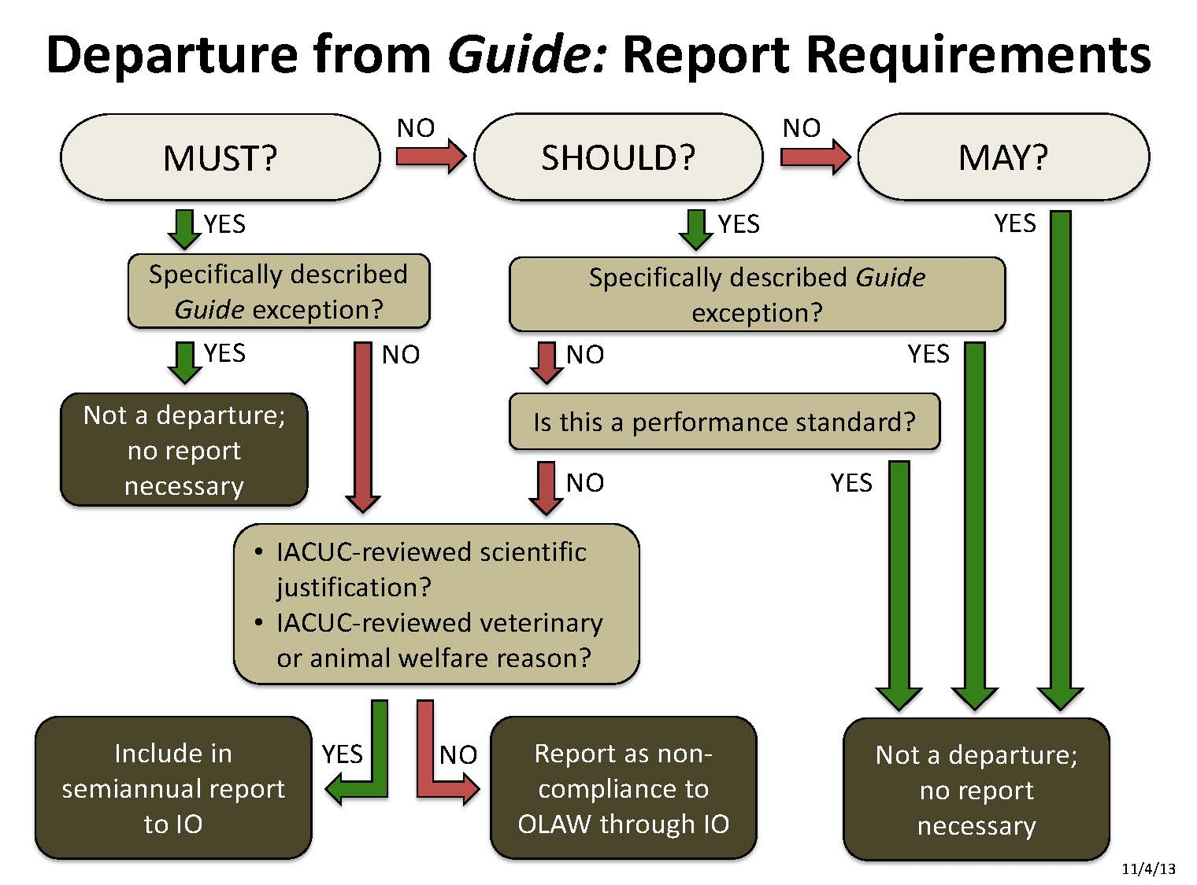
Objectives
Participants will be able to:
Explain the difference between must, should, or may as described in the Guide. (LOC)
(Identify) exceptions specifically described in the Guide. (LOC)
Determine if an animal care and use program (ACUP) finding is an IACUC approved deviation or a validated performance standard. (LOC/HOC)
Categorize the status of a finding as not a departure, an approved departure, or noncompliance. (HOC)
Determine the appropriate reporting requirements for a departure from the Guide. (LOC/HOC)
Notes:
Add citation
Reference materials

Slide 5
Must, Should and May
Shout out:
  What is a “must”?
  What is a “should”?
  What is a “may”?
(insert picture of Guide)
Notes:
Formative Assessment
Objective: Define must, should, or may. (LOC)
Based on your knowledge of the Guide, define a must, should and may.
Together provide an example of each.
Report out to the whole group.
Resources: A copy of the Guide should be provided at each table for groups that may not be familiar with the Guide. If the groups need practice they could use the Guides to refine their definitions and examples.
If the groups do a good job of providing examples then move on to the next activity. If there are many errors continue discussion to clarify.
By sharing one definition and/or example from each group the activity can take less time. (For example, ask Table 1 to share their “must”, Table 2 share their “should”…)
Facilitators will write definitions and examples on easel boards for the group to see.

Slide 6
Approved Departure, Exception, or Performance Standard
Think-pair-share (time: 10 min)
What is an IACUC approved departure?
What is an exception?
What is a performance standard?
As a group create an example of each.
Report out.
Notes:
Objective: Identify an IACUC approved departure, exception or a validated performance standard. (LOC/HOC)
If the groups do a good job of providing examples then move on to the next activity. If there are many errors continue discussion to clarify.
Share one definition and/or example from each group the activity can take less time. (For example, ask Table 1 to share their “must”, Table 2 share their “should”…)
Facilitators will write definitions and examples on easel boards for the group to see.
Provide a short introduction to a scenario and ask the participants to develop this into one of the 3 themes above.

Slide 7
Categorizing and Reporting: Scenarios
Each group will be assigned a scenario. Utilize the flow chart provided to determine which outcome for the finding is appropriate.
Each group appoints a spokesperson to report out the action(s) to be taken based on the determination made.
Notes:
Formative Assessment
Objectives: Categorize the status of a finding as not a departure, an approved departure, or noncompliance. (HOC)
Determine the appropriate reporting requirements for a departure from the Guide. (LOC/HOC)
Practice using tool. Fun to do brain teasers.
Scenarios can be changed up to fit if you would like to focus on specifics with your IACUC.
Could add role playing

Slide 8
Lighting
Scenario A
During a semi-annual facility inspection an IACUC member noticed that there were overhead red lights on in a rat room. Upon further investigation it was determined that the red lights were left on on all day. During the night the white lights were on. According to the protocol the animals will be on a reverse light cycle.
Is this an exception, a departure or a non-compliance from the Guide that should be reported?
Notes:
NONCOMPLIANCE
Inspection issue

Slide 9
Prolonged Restraint
Scenario B
Sheep are confined to a stanchion for up to 30 days post-surgery. They are provided food, water and 24-hour care. They are not provided any break from the stanchion. They can lay down but their head is restrained so that they must face forward. The protocol was scientifically justified and approved by the IACUC.
Is this an exception, a departure or a non-compliance from the Guide that should be reported and to whom?
Notes:
APPROVED DEPARTURE
Sheep confined in stanchion for scientific reasons

Slide 10
IVC Cage Sanitation
Scenario C
Ventilated cages are changed on a 14-day interval. Caretakers assess cages on a daily basis for animal behavior and appearance, and condition of the bedding and cage surfaces. Additionally, the facility conducted a study to correlate cage cleanliness with ammonia levels and CO₂ over a period of time to determine that this was an appropriate cage change interval.
Is this an exception, a departure or a non-compliance from the Guide that should be reported and to whom?
Notes:
PERFORMANCE STANDARD
Cage sanitation for particular facility situation

Slide 11
Social Housing
Scenario D
A facility houses male rabbits singly. The veterinarian was concerned that pair housing could lead to serious injury or death to the rabbits. The justification for single housing is reviewed regularly by the IACUC and veterinarian.
Is this an exception, a departure or a non-compliance from the Guide that should be reported and to whom?
Notes:
EXCEPTION
Guide provides requirements but there can be exceptions for documents scientific reasons or animal welfare

Slide 12
Goal:
Understanding Guide departures and to appropriately report findings to address institutional regulatory burden.
Objectives:
Define must, should, or may. (LOC)
Identify exceptions specifically as described in the Guide. (LOC)
Determine if a finding is an IACUC approved departure or a validated performance standard. (LOC/HOC)
Categorize the status of a finding as not a departure, an approved departure, or noncompliance. (HOC)
Determine the appropriate reporting requirements for a departure. (LOC/HOC)
Notes:
Goal: Understanding Guide departures and to appropriately report findings to address institutional regulatory burden.

Slide 13
Summative Assessment
A pre- and post-test will be given to each individual assessing their knowledge of the following:
      Identification of Guide departures.
      Appropriately report findings.
Notes:
Four different scenarios:
Noncompliance
Approved Departure
Performance Standard
Exception identified in the Guide

